Slide 1









Suitable
JOB CLASSIFIER
Group: Year 2 DAAA-01
Group Members: Zhang Xiang, Joanne, Ulysse & Clara

Slide 2



Introduction
Introduction
Our recommendation machine learning model is build to suggest personalized content to users based on their skill sets and qualifications.
Focus: Help IT Fresh-Graduate
in finding ideal job in IT Sector
Target: Accurately categorize job roles with approximately 70% precision.

Slide 3








Problem
Problem
Unsure of Future Career
Not knowing which job they enjoy.
800+
600+
Applicant Competition
200+
Have to compete with other applicant for job position.
Time Wasted
Spend too much time in researching for multiple job position.

Slide 4



Solution
Solution
Build multi-class classification model to predict job roles such as [ Data Analyst, Data Scientist, Software Engineer and Business Analyst ] through job description texts. Additionally, showing probability how they fit into each position.
Benefit: Job seeker can spend more time in resume and interview preparation.

Slide 5






Development Process
Web Scraping (Credit to my group member)
Data Understanding & Data Cleaning
Modelling & Evaluation
Model Testing & Simple Deployment

Slide 6


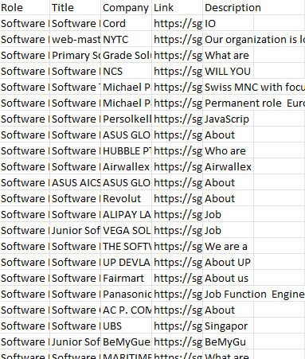
Data Scraping
Excel Sheet with Data Scrape from Indeed.com
All Members Involved
Python Library Used: Beautiful Soup, Selenium, Pandas
Issues Faced:
Banned by cloudflare: Identified as robot. Solution: Use the time.sleep(2) to pause scraping for 2 second. making it act more like a human being.
Duplicate Drop Posting was found. Decide to remove duplicated posting.
Each individual is assigned to a different job search website and scrape 4 different IT roles.
Website scraped: Indeed, Glassdoor, Jobstreet and LinkedIn.
Task to Complete
Look for each job available in each website => Assign different amount of data for each job role to scrape for each member.
Scrape approximately 700 rows of data for each job position. Totalling up to scrape more than 2500/person => More than 10000 in total.
Synchronize data to scrape for each member. E.g. Each member should have column of “Role”, “Title” …
Final: Merging everyone’s dataset and begin Data Understanding and Pre-Processing individually

Slide 7
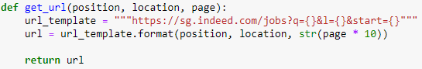
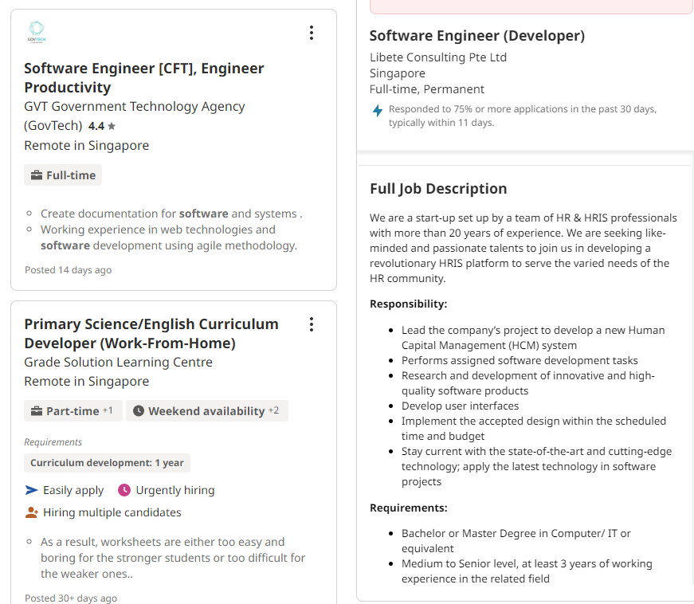
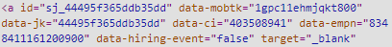
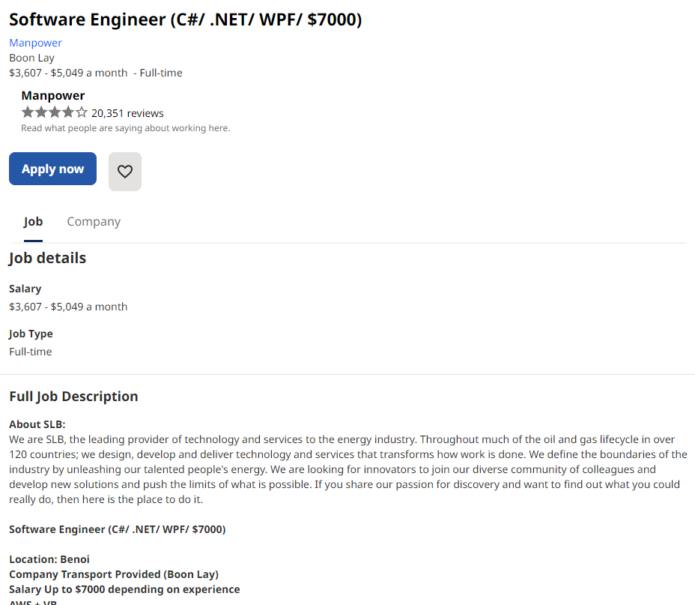

Data Scrape from Indeed.com
Search for the 4 Job Roles in Singapore
Scrape all 4 job roles.
Scrape Description
Data Scraping

Slide 8
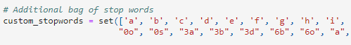
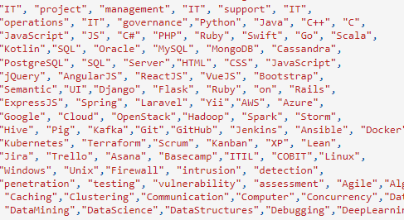
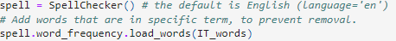
Data Preparation / Cleaning
Important things to highlight
Under Description Column
Drop Non-English Row
Encoding Correction
Remove “\n”
Lowercasing
Remove URL (http:\\...)
Remove Email (info@...com)
Remove Emoji E.g. 😊, ➤
Remove Number + Word with Number
Expand Contraction
Remove Punctuation
Remove stop words (spaCy Library used)
Remove Spelling Error (27078 Spelling Error)
Lemmatization with Part-Of-Speech Tagging
Multiple words joining in one. E.g. (rectificationConfigure) => Not Performed There are words like IOS, spaCy and more which are related to IT term, which could bring useful meaning in the model.
Add Additional Stop Words added
Add Bag of IT term, to prevent it from classifying it as spelling error.

Slide 9
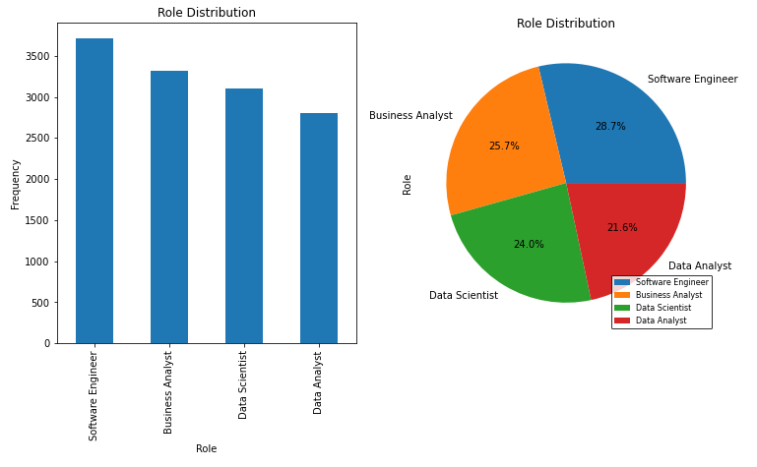
Data Understanding
Important things to highlight
Understand Column and Data Type
(Only require the Label and Job Description to build multi-classification model.)
Check for Missing Value => Bias / Inaccuracies
Found during modelling process after a empty space is stripped off, then pandas l considered it as null value. Drop row without description.
Under Description Column
Encoding Error (utf-8)) E.g. accentureâ\x80\x99s, abilityâ\x80¢
Found backslash n E.g. \n
URL (http:\\...)
Email (info@...com)
Emoji E.g. 😊, ➤
Multiple words joining in one. E.g. (rectificationConfigure, recommendationsProviding)
Phone Number
Contraction
Punctuation
Spelling Error
Stopwords
Short-Term (JavaScript, HTML, UNIX, LINUX)
Multiple Language (负责公司, リスク・コン) 67 rows of non-english text out of 10000+ data => Consider to remove.
Check for Duplicate Value => Avoid Bias / Inefficiency
Consider to remove based on duplicate text.
Evaluate Data Distribution
The highest percentage for software engineer with 28.7% and lowest data analyst of 21.6%.
For different of 7.1% I would consider it in my acceptable range.
Avoid performing oversampling, increase chance of overfitting
Avoid undersampling as well, to prevent losing meaningful data in training model.
Check for Outlier in “Label”
Is it only the 4 target job?

Slide 10
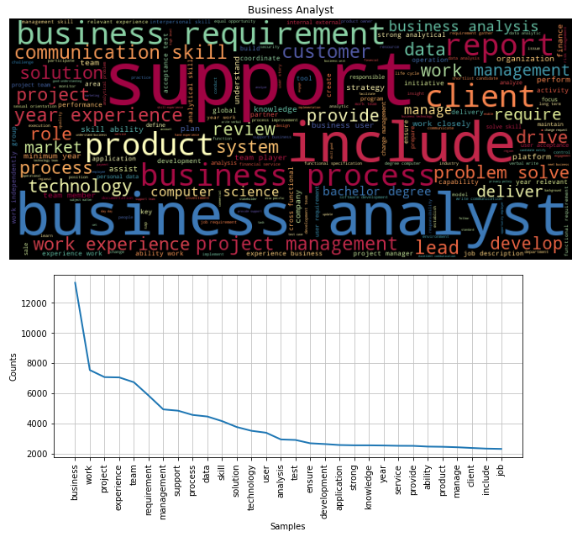
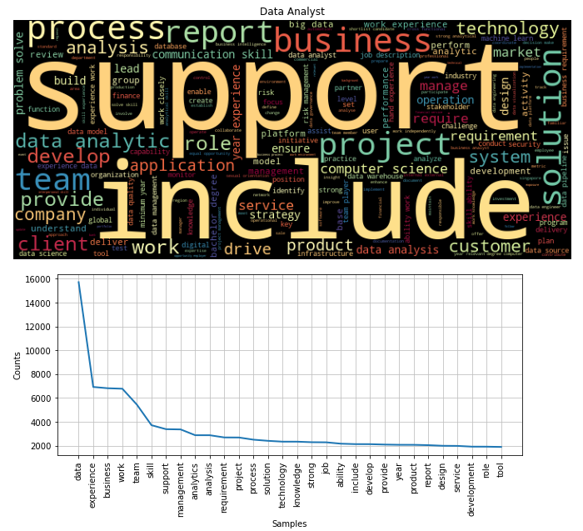
Data Preparation / Cleaning

Slide 11
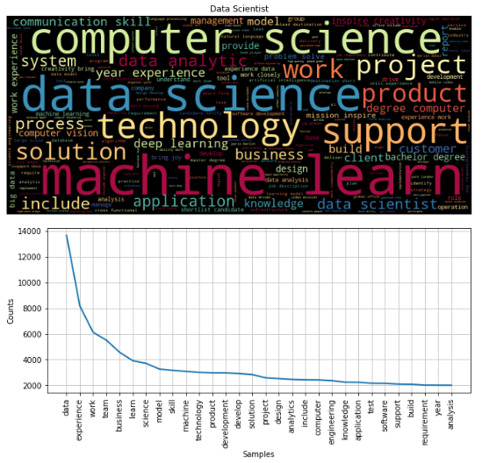
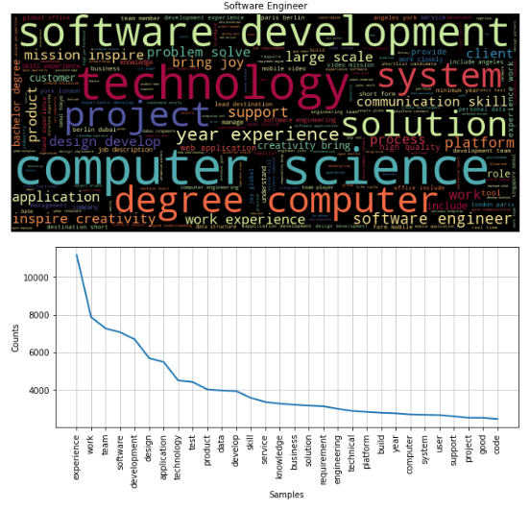
Data Preparation / Cleaning

Slide 12
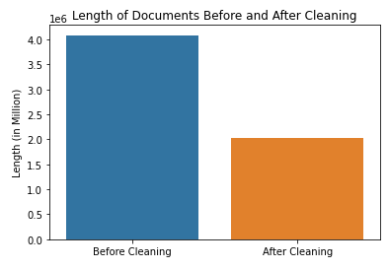
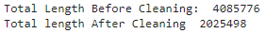
Data Preparation / Cleaning

Slide 13



Baseline Model Comparison
Count vs TF-IDF vs Doc2Vec
Modelling
Feature Selection – Chi Square
Hyperparameter Tuning

Slide 14
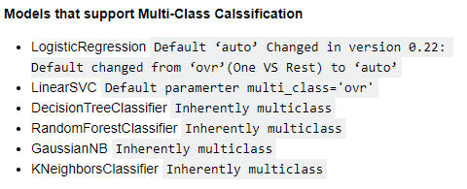
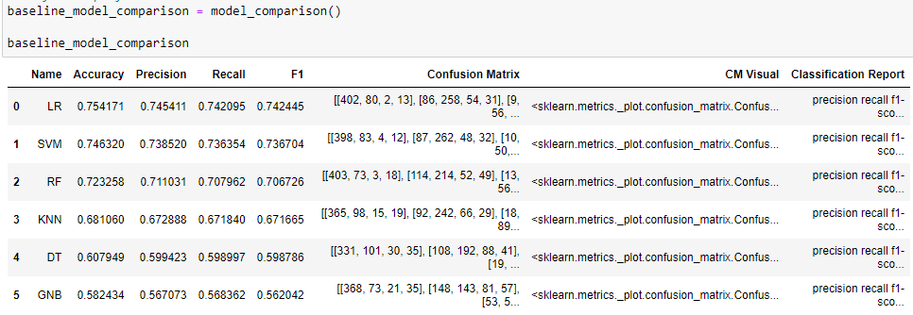
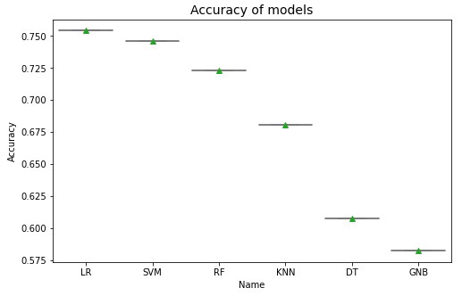
Models Conducted
Baseline Model Comparison
Conducted Multiple Times: Find best performance throughout different cleaning methods and Feature Engineering method (CountVectorizer, TF-IDF, Doc2Vec)
Considered to perform Bigram => Not having enough memory to support the amount of data.

Slide 15
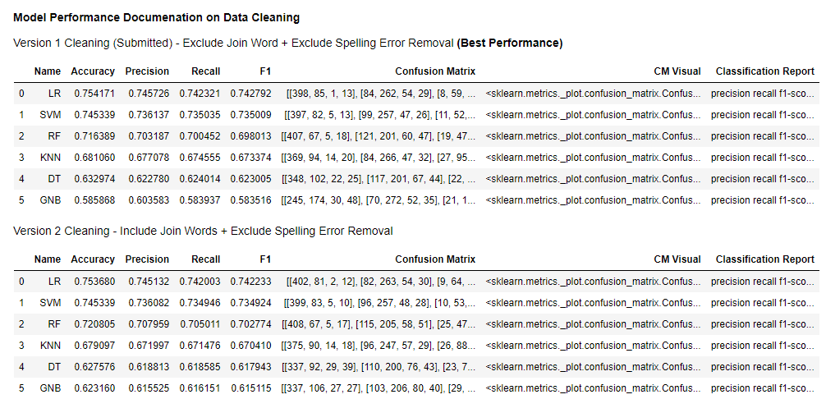
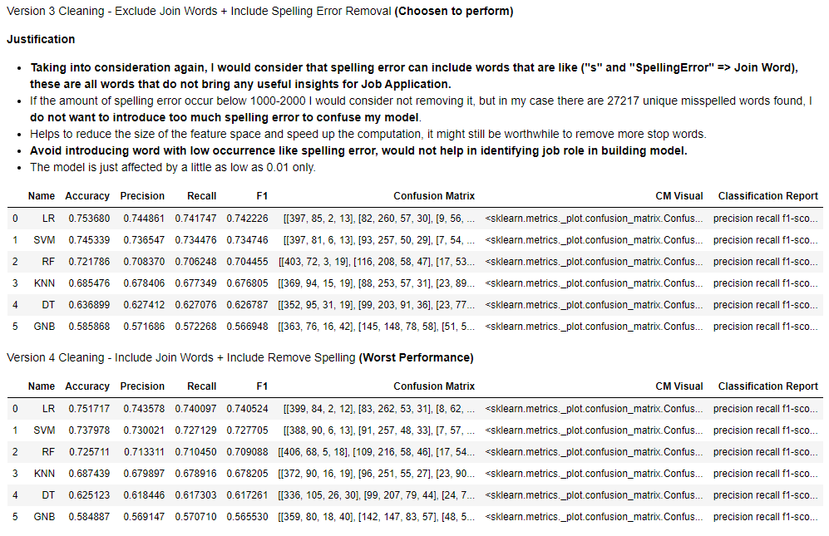
Baseline Model Comparison

Slide 16
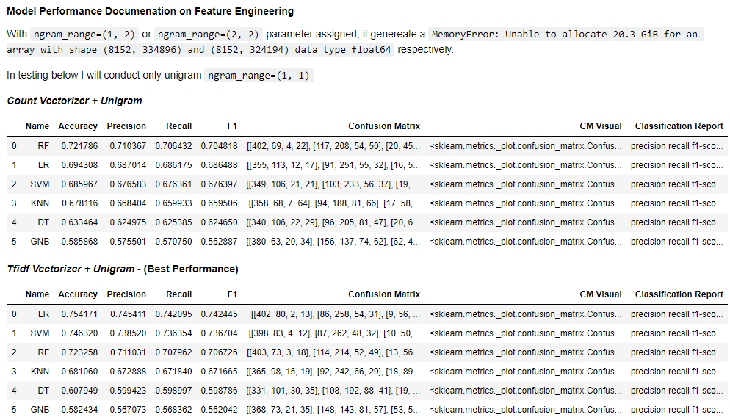
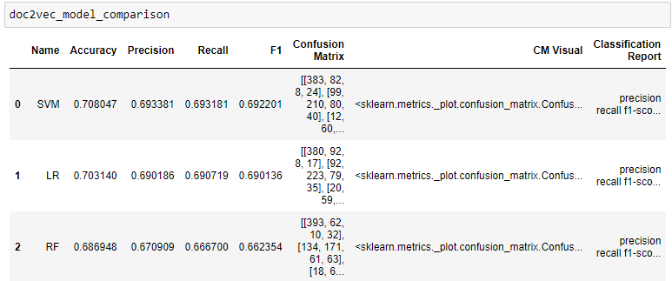
Baseline Model Comparison
Doc2Vec: uses the word similarities learned during training to construct a vector that will predict the words in the new document.

Slide 17
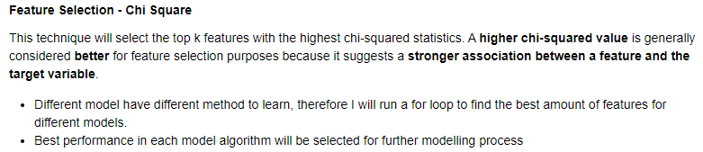
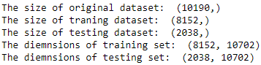
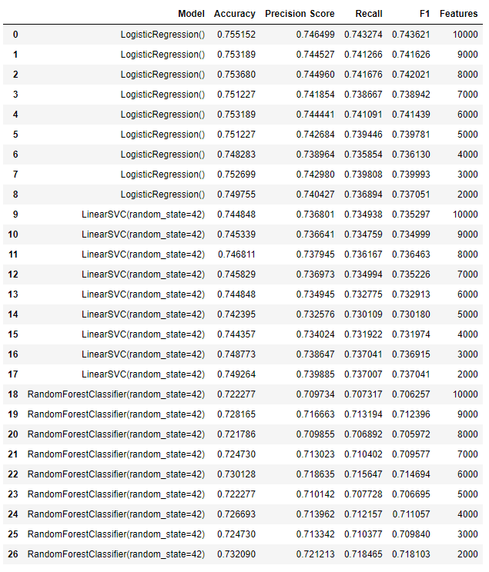
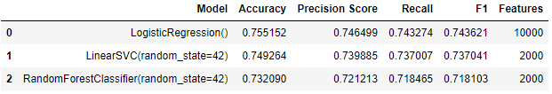
Feature Selection

Slide 18
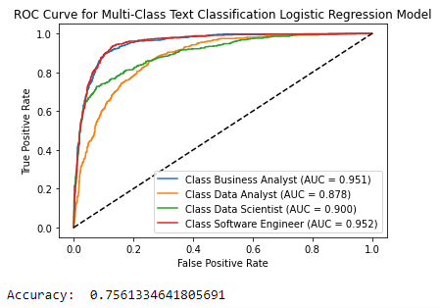
Logistic Regression with 10100 features => Best Performance
Feature Selection

Slide 19
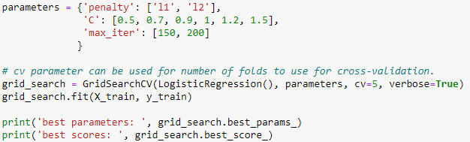
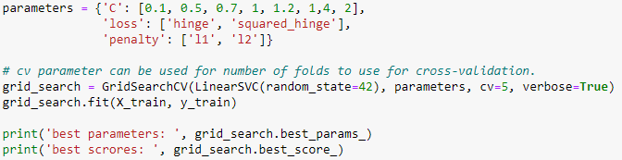
Hyperparameter-Tuning
Logistic Regression GridSearchCV
LinearSVC (SVM) GridSearchCV

Slide 20
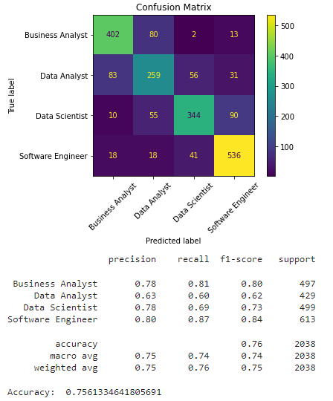
Best Model
Logistic Regression

Slide 21
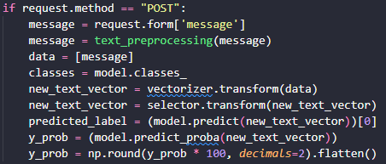
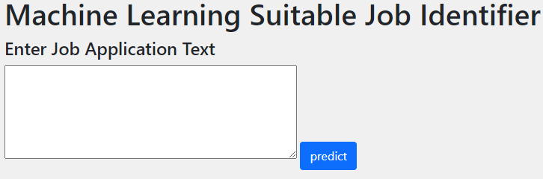
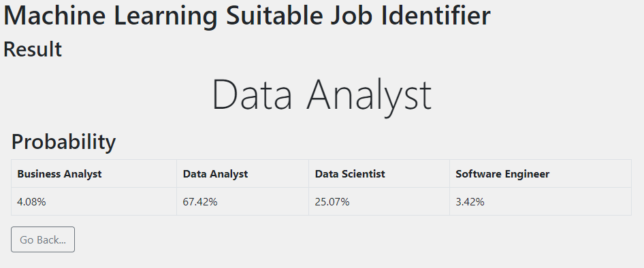
Deployment
Local Deployment
Export final model with pickle library.
Install necessary library in virtual environment
Create Python Flask App
Create function for a simple text pre-processing & modelling
Run prediction
How to use it?
Enter their skills, qualification and tools learned.
Click the “Predict” button.
Generate a label with highest probability
Showing 4 job roles probability as well,
To identify which are other jobs that suit the user as well.
If do not like the first job maybe choose the second highest.
Text Entered: I would be responsible for analyzing and interpreting large sets of data to help organizations make better decisions. I would need strong skills in data analysis, statistics, and programming, as well as a deep understanding of data visualization tools and techniques. I would also need to have strong communication skills to be able to present complex data in a way that is easy to understand. Pursuing certifications such as the Certified Data Management Professional (CDMP) would help me stay current with the latest trends and technologies in the field.
Should predict as: Data Analyst

Slide 22
Deployment
Output
Local Deployment
Export final model with pickle library.
Install necessary library in virtual environment
Create Python Flask App
Create function for a simple text pre-processing & modelling
Run prediction
How to use it?
Enter their skills, qualification and tools learned.
Click the “Predict” button.
Generate a label with highest probability
Showing 4 job roles probability as well,
To identify which are other jobs that suit the user as well.
If do not like the first job maybe choose the second highest.

Slide 23
Thank You!
Group Name: Anyhow
Group Members: Zhang Xiang, Joanne, Ulysse & Clara

